Slide 1

CREDIT RISK PREDICTION

Slide 2
OUTLINE
Executive Summary
Development Plan
Model Performance

Slide 3
EXECUTIVE SUMMARY

Slide 4
EXECUTIVE SUMMARY
Objective – Build a data driven machine learning model to predict if an applicant is 'good' or 'bad’ customer for credit card.
Data Sources
Application Data – This consists of Historical Customer Applications & Demographic Attributes
Credit Data – This consists of historical dues and credit data
1.7%
~36k
181k
$110M
Bad credit rate
Total Clients
Avg Income of loan applicant

Slide 5
DEVELOPMENT PLAN

Slide 6

DEVELOPMENT FRAMEWORK

Slide 7

FEATURE IMPORTANCE METHODS
Weight of Evidence and Information value
Calculated the information value and weight of evidence on each of the parameters
Modelling Approach
Implemented 6 machine learning algorithms to the data and calculated the feature importance on the algorithm with the highest accuracy to get the most important parameters to look out for when disbursing loans

Slide 8

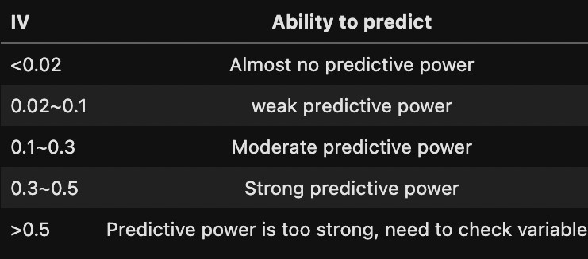
WEIGHT OF EVIDENCE AND INFORMATION VALUE
WOE & IV
IV is based on an analysis of each independent variable without considering other predictor variables. WOE - Closely related to the IV value, WOE measures each grouped attribute's strength in predicting the Dependent Variable's desired value.
This table shows the value and the predictive power

Slide 9
WEIGHT OF EVIDENCE AND INFORMATION VALUE
Feature | Information Value
#_of_pastdues | 0.2007
begin_month | 0.1681
paid_off | 0.1107
Age | 0.1021
Income | 0.087
no_loan | 0.0708
Experience | 0.0557
Family_Status_Single | 0.0217
Education_secondary | 0.0167
Own_Car | 0.0162
Income_Type_Pensioner | 0.0143
Own_Phone | 0.0141
Income_Type_Working | 0.0114
Is_Working | 0.0114
Family_Status_Married | 0.0098
In_Relationship | 0.0098
Family_Member_Count | 0.0084
Education_Higher education | 0.0066
Household_Size | 0.0065
Housing_Type_House / apartment | 0.0065
Own_Realty | 0.0063
Own_Email | 0.0058
Own_Work_Phone | 0.0037
Gender | 0.0033
Education_Academic degree | 0
Income_Type_Student | 0
Housing_Type_With parents | 0
Own_Mobile | 0
0.20
This result shows that WOE and IV alone is not enough to arrive at a conclusion, We will use machine learning technique to get the accurate result
Highest IV
The #_of_pastdues has the highest IV.

Slide 10
FINAL SELECTED FEATURES
Feature | IV | Feature Importance
Own_Car | 0.0162 | 0.0436
Own_Realty | 0.0063 | 0.0562
Income | 0.087 | 0.0598
Family_Member_Count | 0.0084 | 0.0205
begin_month | 0.1681 | 0.0493
Is_Working | 0.0114 | 0.0193
In_Relationship | 0.0098 | 0.0210
Age | 0.1021 | 0.0497
Experience | 0.0557 | 0.0370
Education_Higher education | 0.0066 | 0.0664
Education_secondary | 0.0167 | 0.0786
Family_Status_Single | 0.0217 | 0.0948
'paid_off', '#_of_pastdues' and 'no_loan' features are not included in the modelling. For example, if we know #_of_pastdues=0 of the customers then we also know with complete certainty that the target=0. These 3 features did not be included in the model because they were used to construct the target.
Other features used in modeling were selected according to the common results of different feature selection methods like IV, RFE(Recursive Feature Elimination, Extra Trees Classifier etc.

Slide 11
MODEL PERFORMANCE

Slide 12
MACHINE LEARNING APPROACH
LOGISTIC REGRESSION
DECSION TREE
RANDOM FOREST
65%
96% A decision tree is a non-parametric supervised learning algorithm, which is utilized for both classification and regression tasks. It has a hierarchical, tree structure, which consists of a root node, branches, internal nodes and leaf nodes.
96% The random forest has the highest accuracy. Random forests are an ensemble learning method for classification, regression, and other tasks that operates by constructing a multitude of decision trees at training time. For classification tasks, the output of the random forest is the class selected by most trees.
Logistic regression is a statistical analysis method to predict a binary outcome, such as yes or no, based on prior observations of a data set. A logistic regression model predicts a dependent data variable by analyzing the relationship between one or more existing independent variables.
Metric | Value
Accuracy | 50%
Precision | 97%
Recall | 50%
F1 Score | 65%
Metric | Value
Accuracy | 96%
Precision | 97%
Recall | 96%
F1 Score | 96%
Metric | Value
Accuracy | 95%
Precision | 97%
Recall | 95%
F1 Score | 96%

Slide 13
MACHINE LEARNING APPROACH
K NEAREST NEIGHBORS
XGBOOST
CATBOOST
91%
96% It is a decision-tree-based ensemble Machine Learning algorithm that uses a gradient boosting framework. Execution speed and high performance are the main reasons to use XGBoost.
97% CatBoost is an open-source algorithm based on gradient boosted decision trees. It supports numerical, categorical and text features. It works well with heterogeneous data and even relatively small data.
K-Nearest Neighbor (KNN) algorithm predicts based on the specified number (k) of the nearest neighboring data points. Here, the pre-processing of the data is significant as it impacts the distance measurements directly. Unlike others, the model does not have a mathematical formula, neither any descriptive ability.
Metric | Value
Accuracy | 85%
Precision | 97%
Recall | 85%
F1 Score | 91%
Metric | Value
Accuracy | 95%
Precision | 97%
Recall | 95%
F1 Score | 96%
Metric | Value
Accuracy | 97%
Precision | 97%
Recall | 97%
F1 Score | 97%

Slide 14
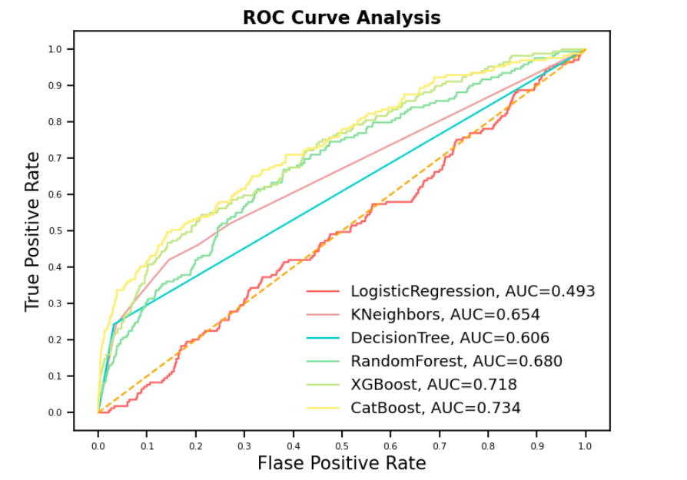
ROC CURVE
Inference
CAT Boost have the highest AUC ROC Value

Slide 15
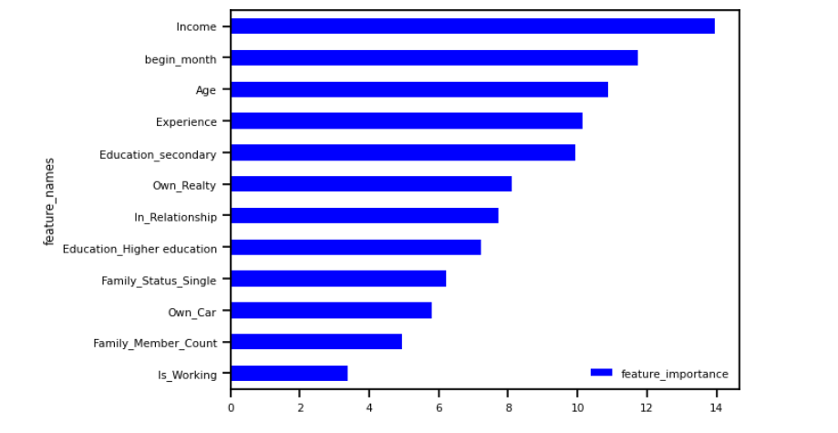
FEATURE IMPORTANCE
CATBOOST
This feature importance was created on the CatBoost model
Inference
From this graph, we can observe that below parameters have highest influence to consider when issuing the credit card.
Income
Begin month
Age
Experience
Education Secondary

Slide 16


CONCLUSION & PROJECTION
XX%
75%
reduction in default rate
Reduction in time required make loan decision
this model is projected to reduce default rate by XX% in the next 6 months, thereby saving the company million of dollars of potential bad debt
This model will reduce the time spent in making loan decision drastically

Slide 17

RECOMMENDATION
USE WITH HUMAN
The best way to use this model is to combine it with human intelligence at the early stages while we work on fixing the
other edge cases
RETRAIN AND SET THRESHOLDS (Implement MLOPs)
The model is still at the infant stage, retraining is required and thresholds for model accuracy should be set, once the model accuracy drops to a certain threshold, it should alert the machine learning engineer

Slide 18

Questions?

